Slide 1
Learning Lantern
Web Based
Learning Management
System Project
Supervised by:
Dr. Mustafa Salem Abu-Bakr
Faculty of Computer and Information
Assiut University

Slide 2
Project Team Members
We host using Azure cloud platform
Ahmed Ezzat Gaber
Omnia Ahmed Bakr
Ahmed Mohamed Fathy
Ahmed Samir Meky
Omnia Mohamed
Aya Abo El-Ela Khaled
Ibrahim Mohamed Ali
Khlood Elhuisseny

Slide 3
01
What we will Create
We will create a group of integrated services that enhance the E-learning experience and offers simplicity of use and convenience of Usage
02
1.2.Project Objective
Building a set of services to help educational institutions moving to online learning
03
1.3.Project Overview
1. This Project is about helping universities & educational institutions moving to Online Learning easily by providing a set of useful services that are essential in the online learning process.
2. The universities & educational institutions can subscribe to one of more of the provided services according to their needs.

Slide 4
Services
Online text editor
Calendar
&
To-do List
Video hosting
. virtual classroom
virtual classroom
Real-time Chat
Interactive Video

Slide 5
Technology
Frontend
1) Html5, css3,
JavaScript.
2) Angular.
3) VedioJS.
4) TinyMCE
Backend
1) ASP .Net core
2) Entity framework
3) SQL Server
4) Microsoft Azure

Slide 6
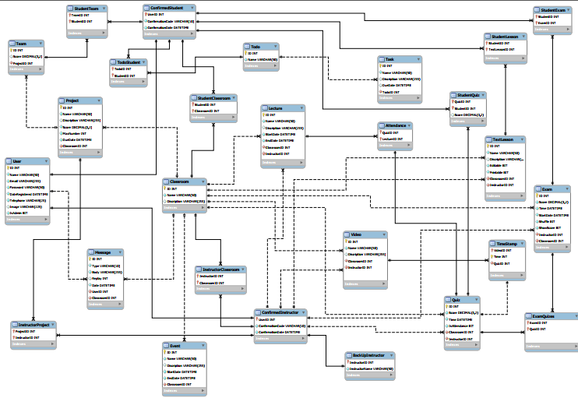


Database Design

Slide 8
Database
Implementation
Get a modern PowerPoint Presentation that is beautifully designed. I hope and I believe that this Template will your Time, Money and Reputation. Get a modern PowerPoint Presentation that is beautifully designed. I hope and I believe that this Template will your Time, Money and Reputation. You can simply impress your audience and add a unique zing and appeal to your Presentations.
We used SQL language to implement our database.
We used SQL Server Management Studio (SSMS).
Our database model consists of 28 tables including bridge tables.

Slide 9
Frontend Implementation
Use HTML, CSS, Java script, Angular framework, Video JS, TinyMCE,and Web RTC to design and implement
website pages

Slide 10
Backend Implementation:
Use Microservice Architecture and Web API.
Schema used to implement each
service's API is:
Each service is a project itself
that contain the following:
Controller
Data Transfer Objects (DTOs):
Models
Repositories

Slide 11
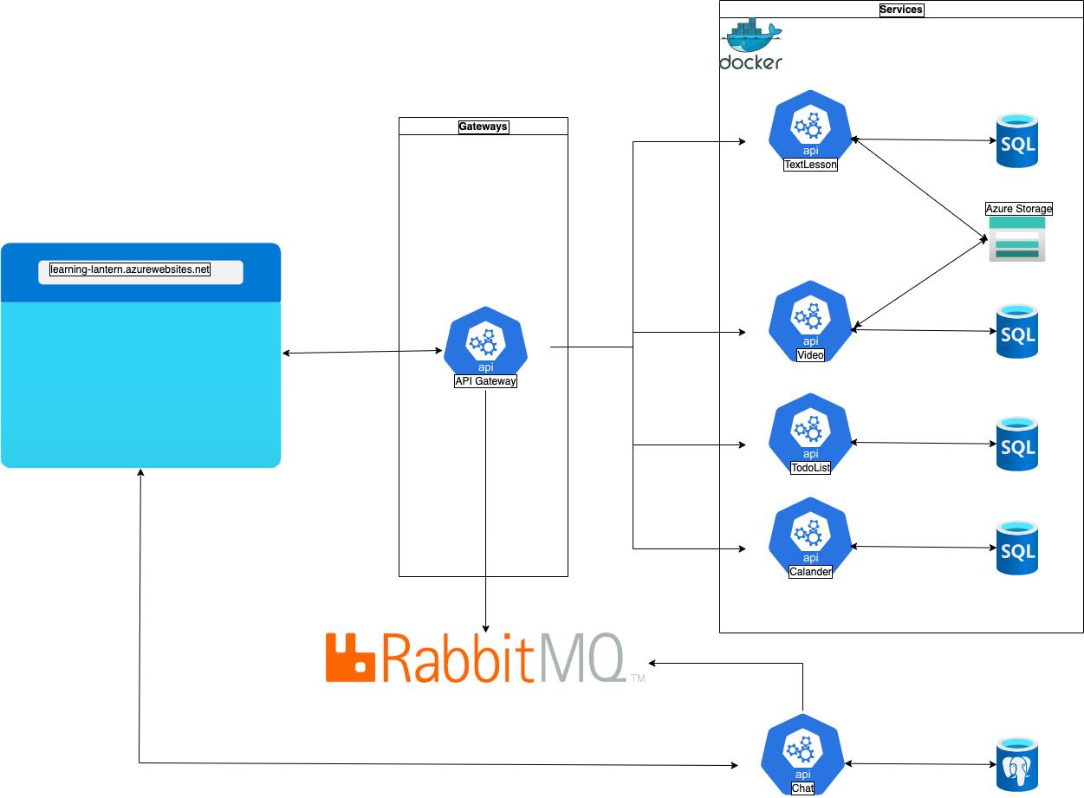
Microservices Architecture

Slide 12
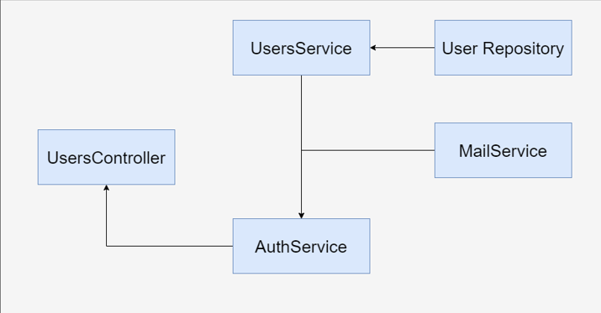
User API Architecture

Slide 13
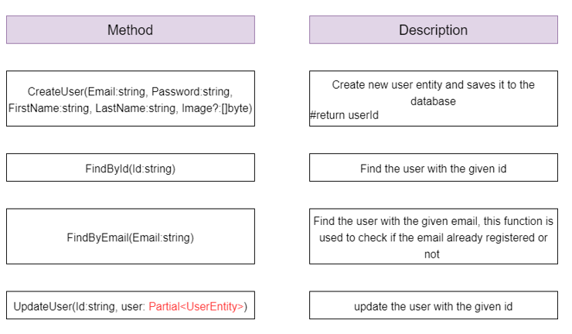
User Service

Slide 14
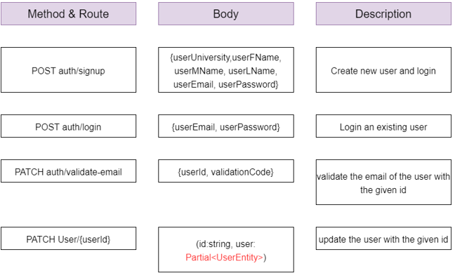
User Controller

Slide 15
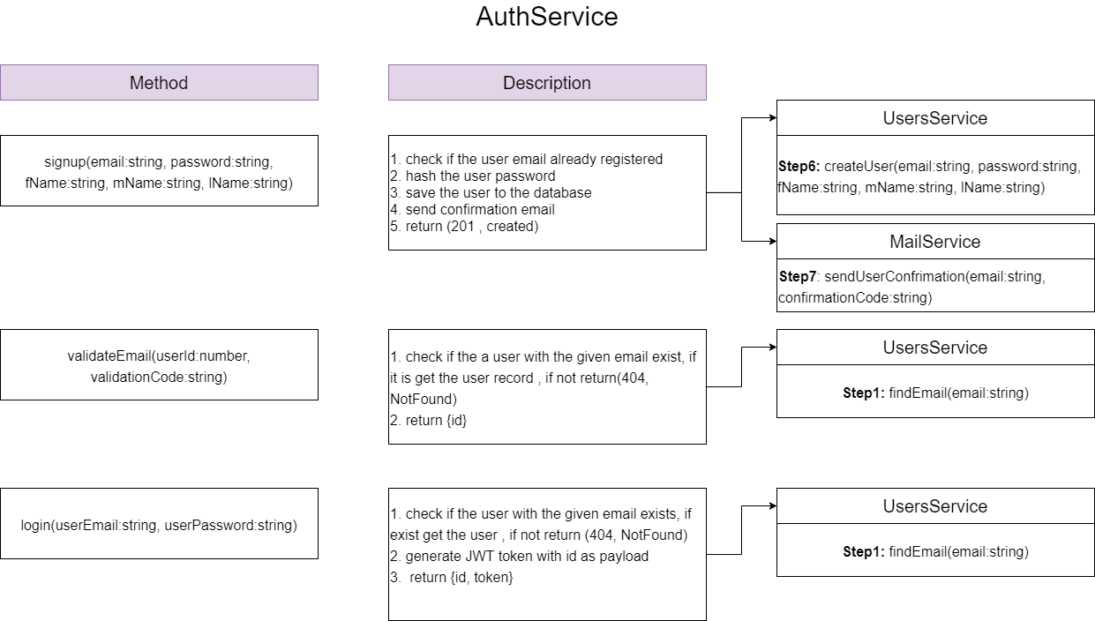
Authorization service

Slide 16
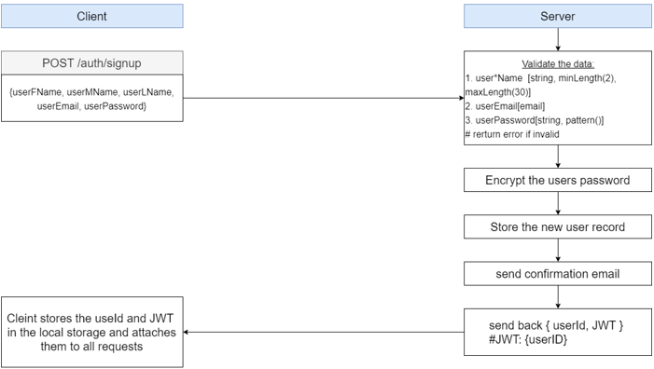
Sign Up or Registration
In this, the interested users get registered by selecting their desired first name, last name, password and by providing other necessary details.
Each user can register only one time. Details of each person along with their username and password are saved permanently in the database.

Slide 17
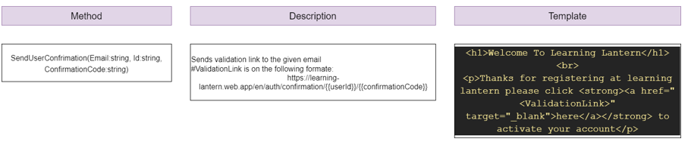
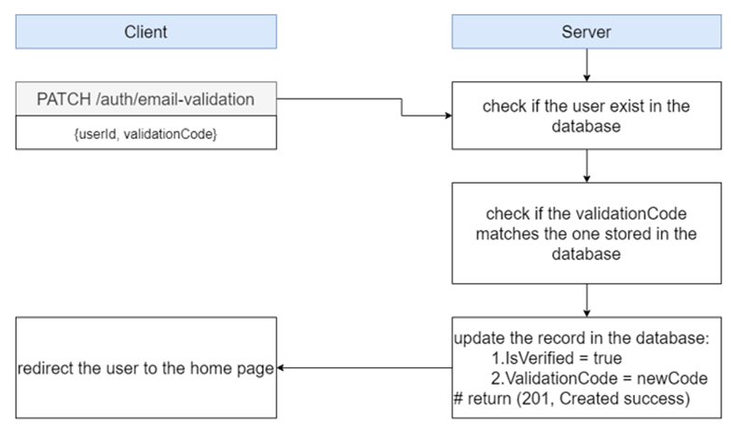
Validate Email
After the registration process, the user receives a confirmation message to the email he registered with.

Slide 18
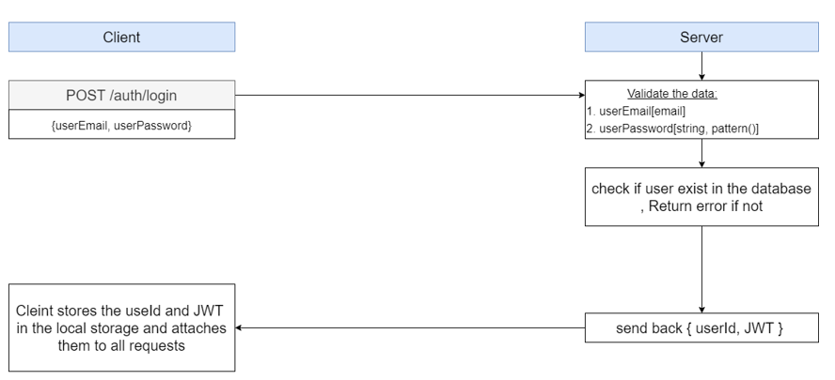
Sign In
After confirmation process, the user can try to sign in by entering the university name, email, and password.

Slide 19
There are 4 types of roles on the website
Admin
Student
Instructor
University Admin

Slide 20
Admin
Developers of the website
University Admin
University managers and administrators
Student
University students
Instructor
Doctors and assistants

Slide 21
Hosting
We host using Azure cloud platform
Testing
We use a test scenario strategy, for each endpoint, we test every possible scenario that can happen by the user.
First, we Mock the database by using a new In-Memory database.
Then for each repository we write a unit testing for each function.

Slide 22
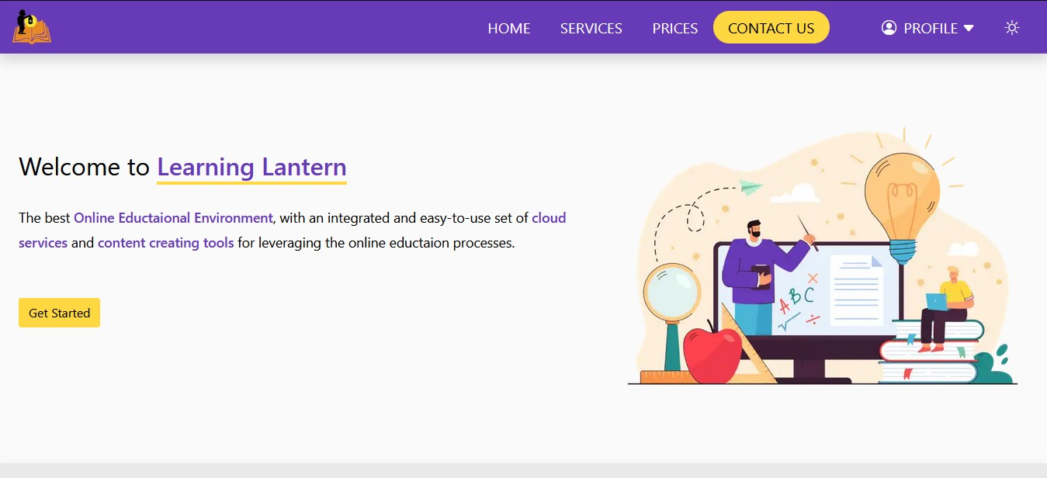

Slide 23
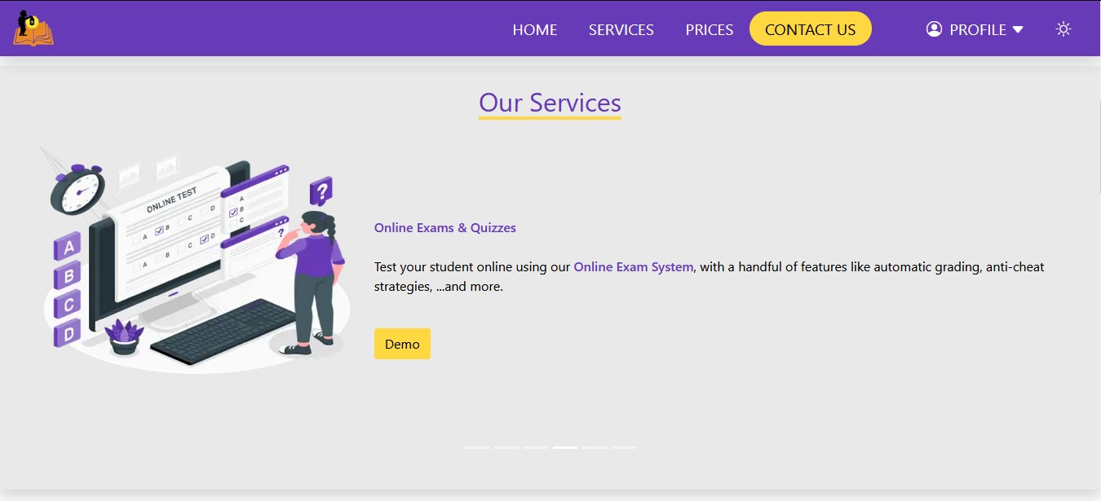

Slide 24
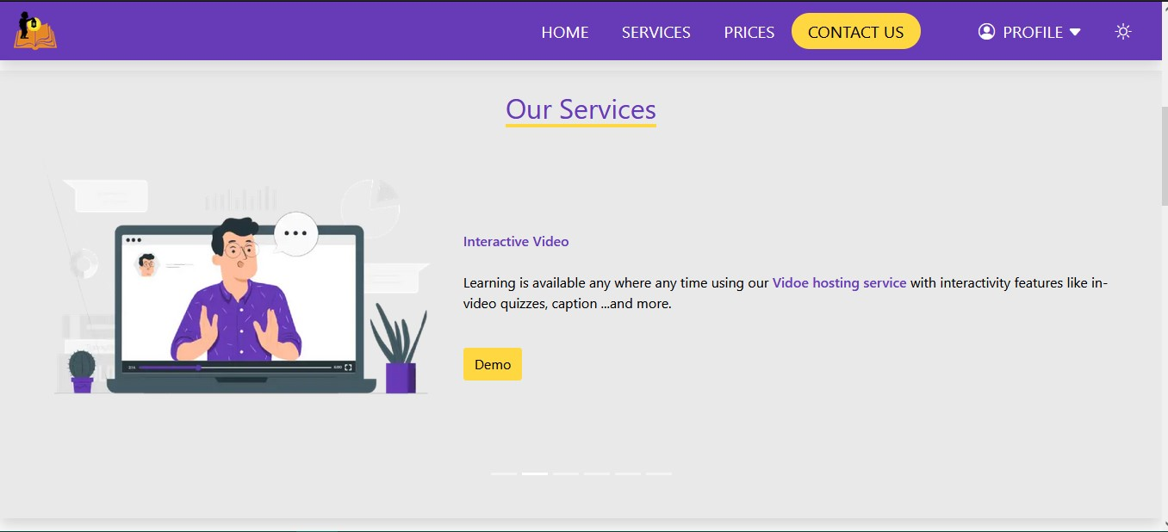

Slide 25
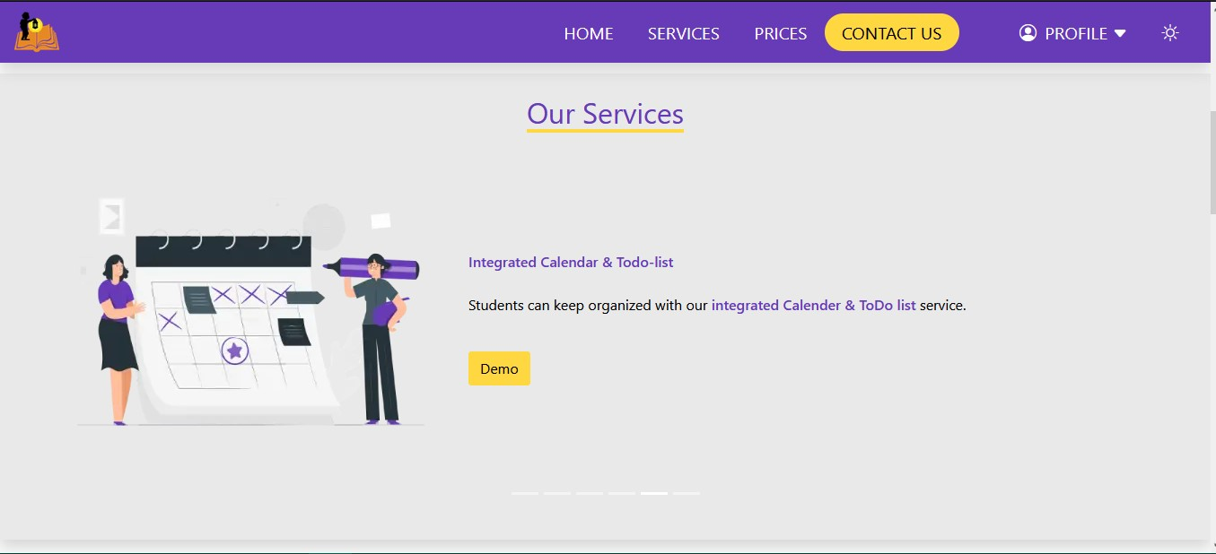

Slide 26
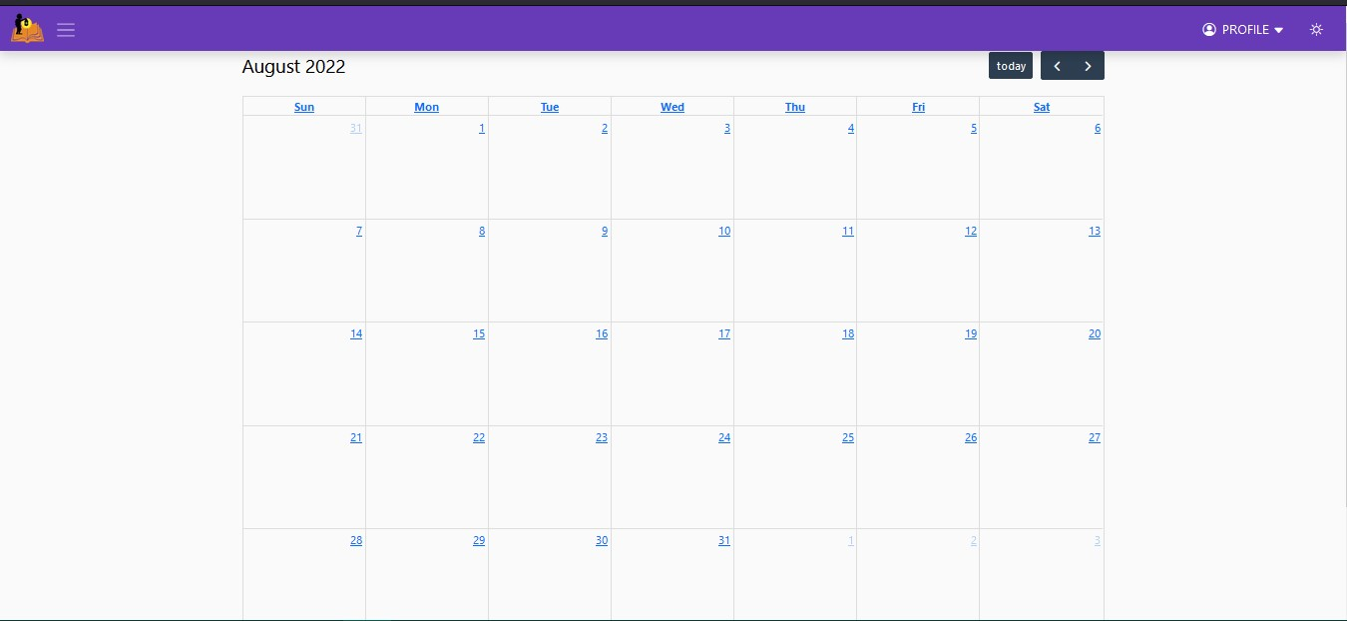

Slide 27
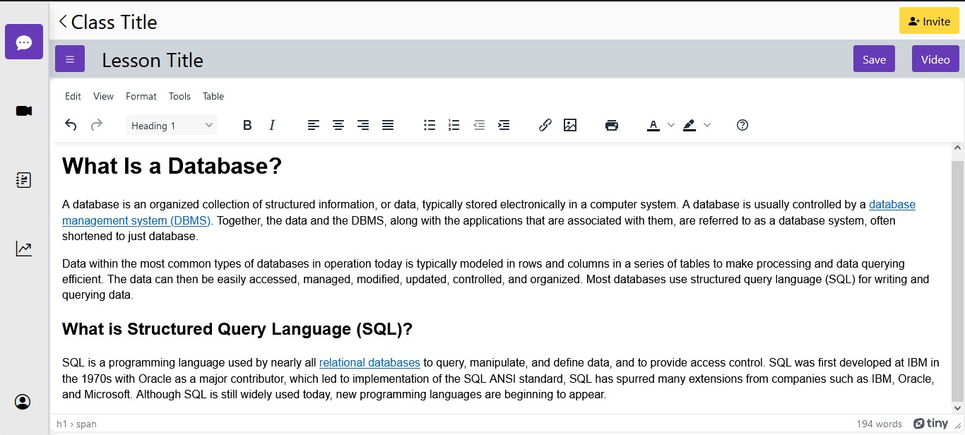

Slide 28
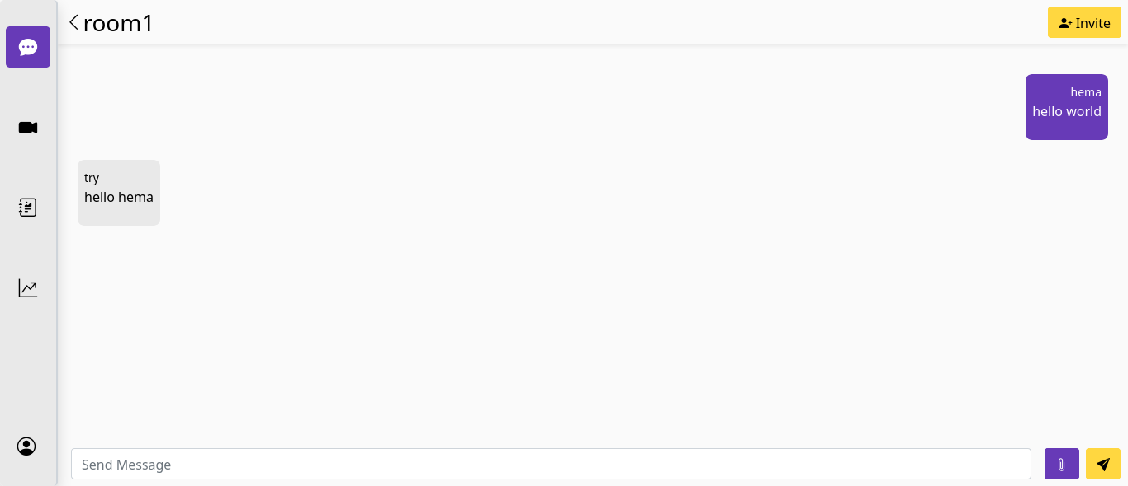

Slide 29
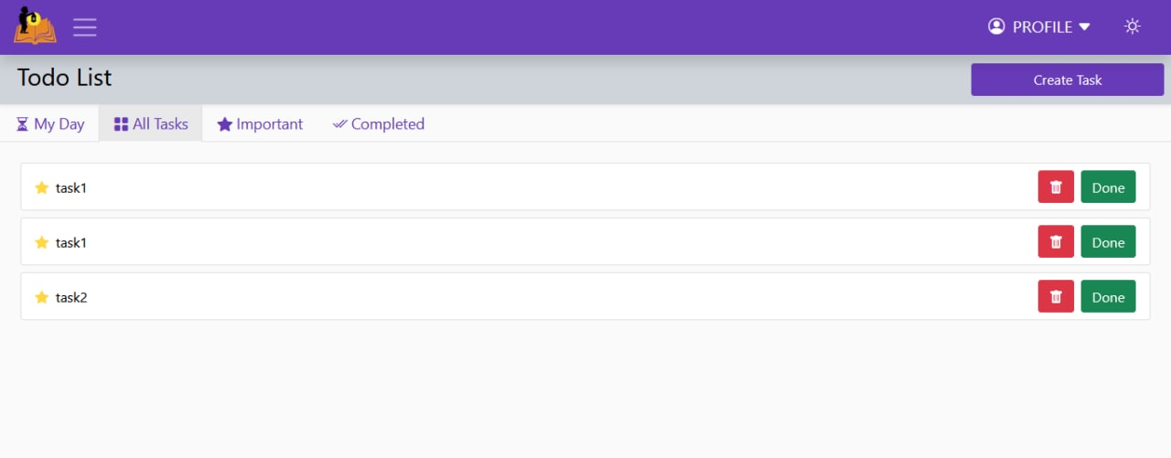

Slide 30
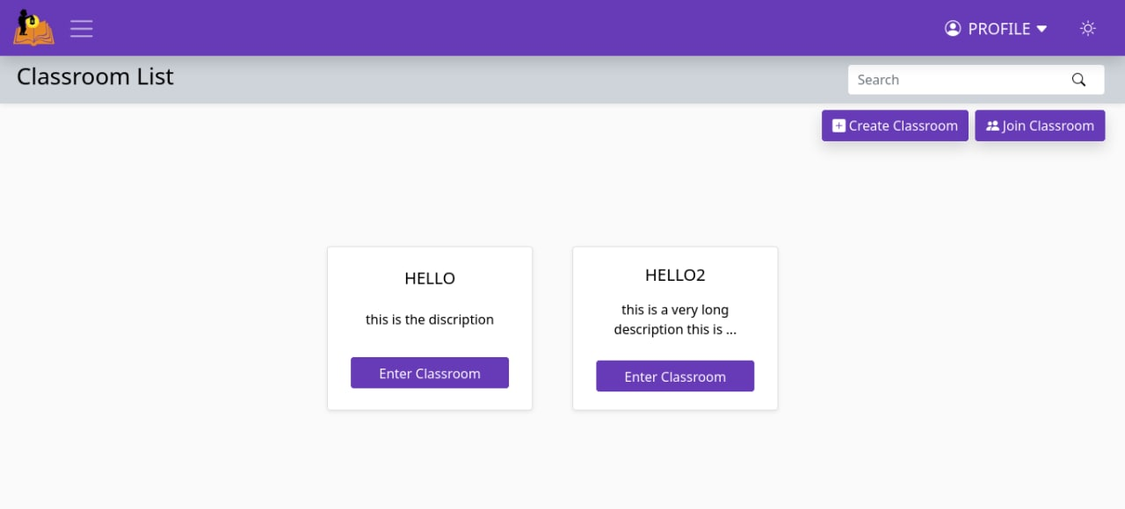

Slide 31
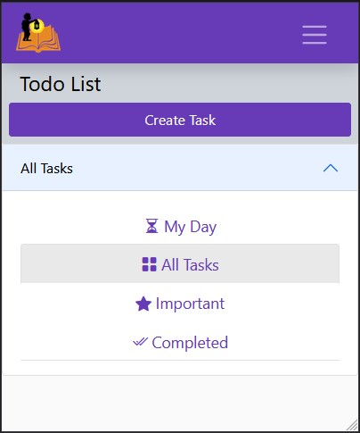
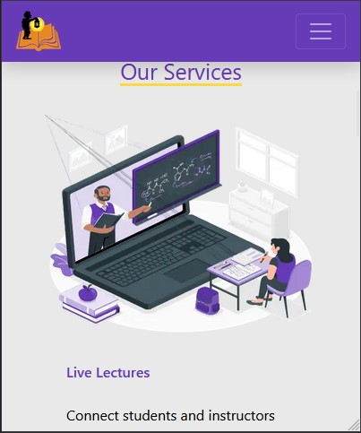
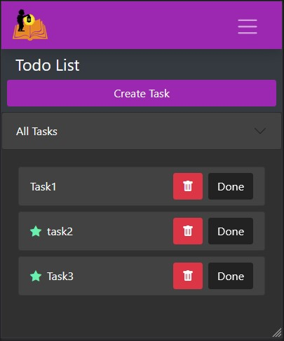
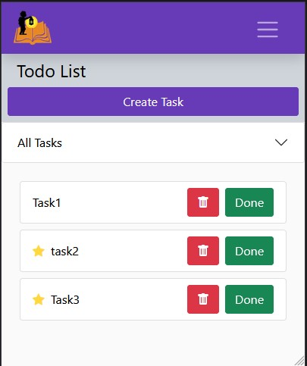
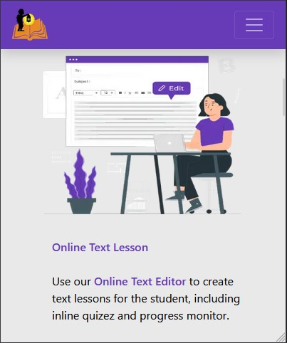
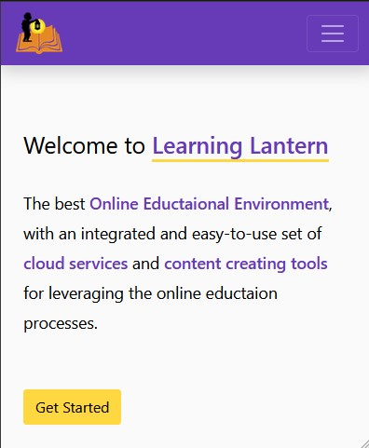
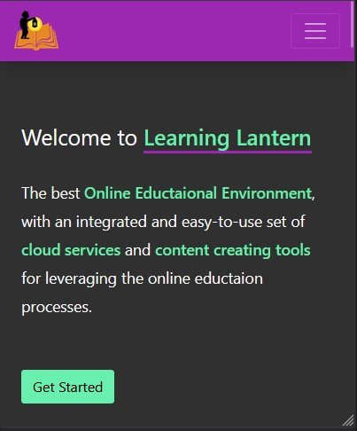
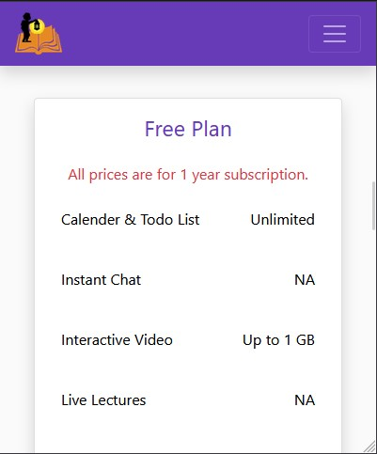

Slide 32
THANK YOU

